Slide 1

Golf BUDDY
CS 3651 Fall 2023
Ian Boraks and Fernando Rodriguez

Slide 2
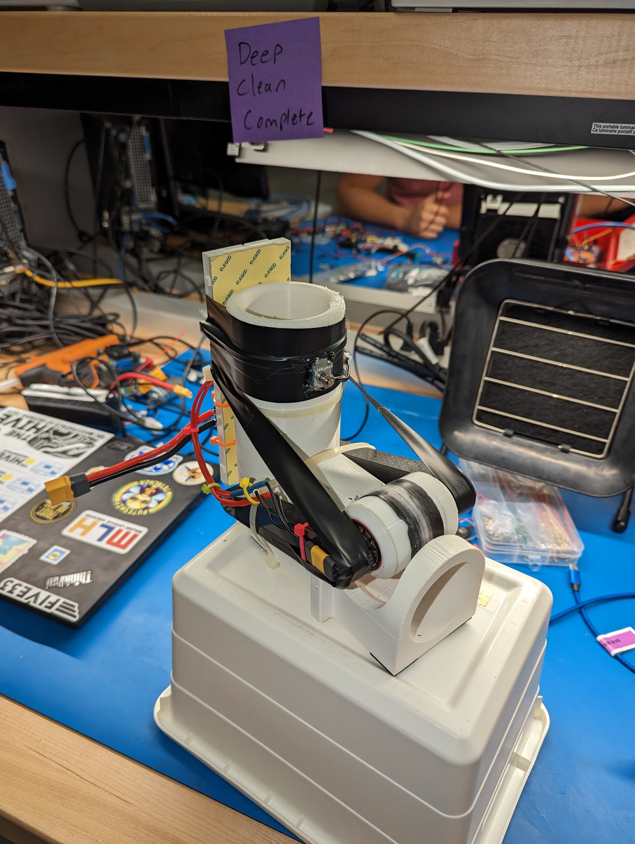
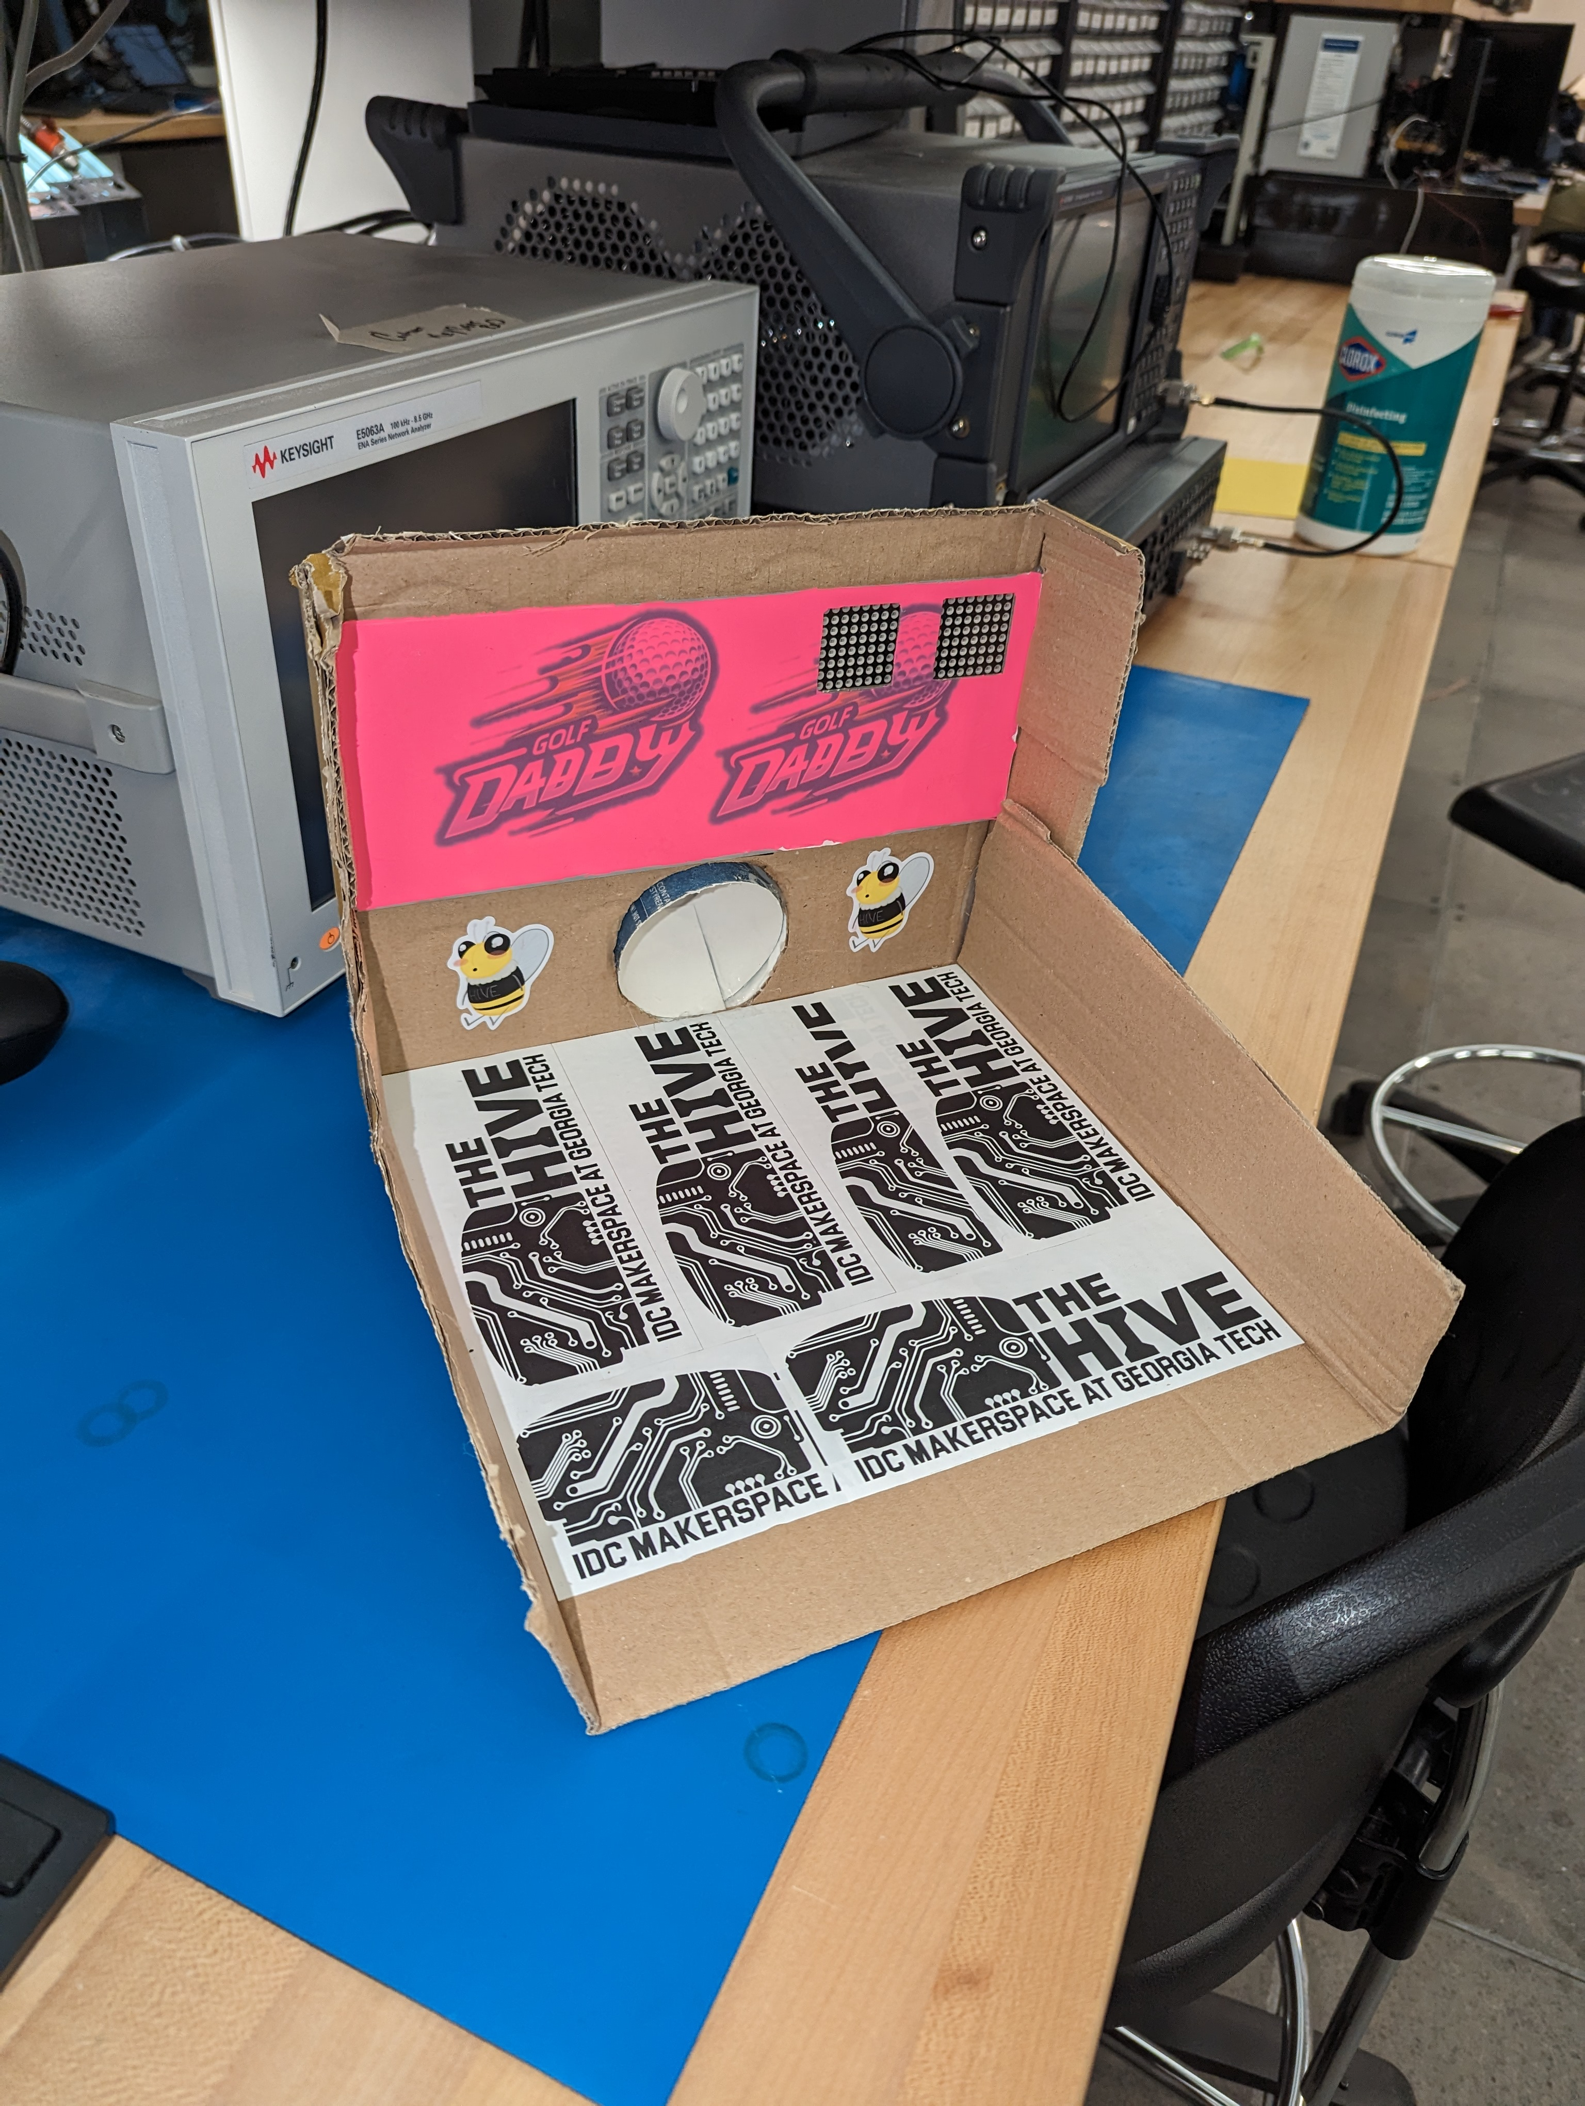
Motivation
We set out to revolutionize the world of mini gold with the creation of the High-Speed Golf ball shooter. Our initial goal was to craft a tool that not only refined golfers' putting prowess but also injected a new level of competition and excitement into the game.

Slide 3
Implementation
Launcher
Game
The launcher uses a 50A ESC and DRONE MOTOR to propel the ball forward at rapid speeds. The housing is 3d printed and the ball and roller are printed from TPU.
A high-powered head-to-head game where 2 players compete against each other to win. Current game mode has the players shoot 16 times each and makes more shots wins
Hole
Unique Solution
The hole utilizes a dot matrix to display score and a limit switch and microphone to detect the ball. There is also a laser cut back plate that is vinyl wrapped and sublimated with our logo.
The initial design had the launcher return the ball to the user. However, in the spirit of innovation and fun we wanted to use the power of the launcher better and have the user use the launcher to putt the ball .

Slide 4
Challenges
RFID
The initial setup included golf balls embedded with RFID tags, allowing for seamless tracking of points for every player's score. However, the RFID vision hit a roadblock when the speed of the balls passing through proved too rapid for our reader to capture readings accurately. Even tuning the motor down the speeds were still too great. This challenge was compounded by the fact that while the RFID tags themselves worked as intended, when placed inside the golf ball, their performance decreased.
Solution
The RFID problem forced us to pivot to a solution that was more robust that includes limit switches and a microphone to detect the ball. The limit switch detects if the ball has passed through the hole. The microphone is used to detect is a user as shot the ball.

Slide 5
Live Demo

Slide 6
Future Work
More refined hole made from all metal and/or 3d printed
More game modes
Wireless communication between launcher and hole

Slide 7
THANK YOU

